Slide 1

BelleVille Dentail
eProject SEM 1
Group 4 – Batch 175
Instructor: Mr. Hoang Dinh Ngoc Minh
Members: Nguyen Huynh Duc
Huynh Van Dang
Ho Thanh Khanh

Slide 2





Content of project
Introduction of project
System Analysis and Design
Website Layout
Technical
Advantages, Disadvantages & Oriented Development

Slide 3

I.
Introduction of project
BelleVille’s introduction
Project’s Requirements

Slide 4

II. System Analysis and Design
USECASE:
View Webpages
Solve dental problems
Book an appointment
Informaton of doctors
Follow the news

Slide 5
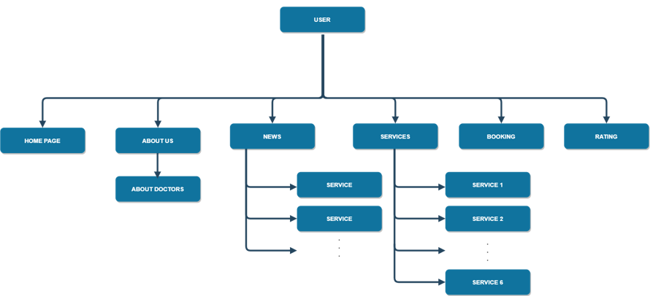
II. System Analysis and Design
SITEMAP:

Slide 6
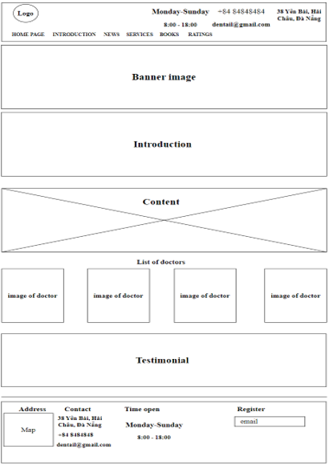
III. Website Layout:
HOMEPAGE:

Slide 7





q
IV
Technical
HTML5 & CSS3
JQuery
Bootstrap

Slide 8
V
Advantages, Disadvantages & Oriented Development
Advantages:
User-friendly interface
Mobile-friendly

Slide 9
V
Advantages, Disadvantages & Oriented Development
Disadvantages:
Limited capabilities and time

Slide 10
V
Advantages, Disadvantages & Oriented Development
Oriented Development:
Create a website where users can update and disseminate information about dentistry.

Slide 11
Kết luận 1
Text
Thanks For Watching!
Have a great day everyone
Kết luận 2
Text

